Slide 1
Earthwork Machinery and Compacting Equipment's
Highway Construction project broadly divided in two phases:
Earthwork and preparation of subgrade
Pavement Structure
The Earthwork mainly consists of preparation of the subgrade, to be suitable to receive the subsequent construction of pavement structure.
Excavation is the process of cutting or loosening and removing earth including rock form its original position, transporting and dumping it as fill or spoil bank. It may be divided as excavation or cutting, grading and compaction. The depth of excavation is decided among other factors, on requirement of vertical profile of the road.
Excavation equipment commonly used in highway projects include bulldozers, power shovels, draglines clamshell, scrapers and hoes.

Slide 2
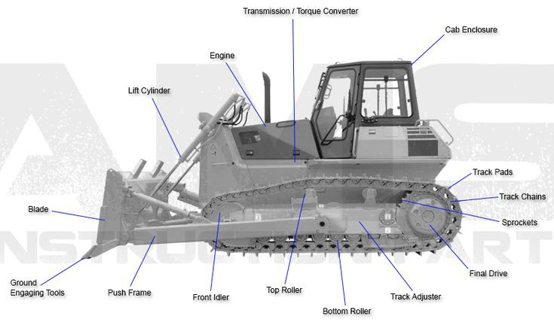
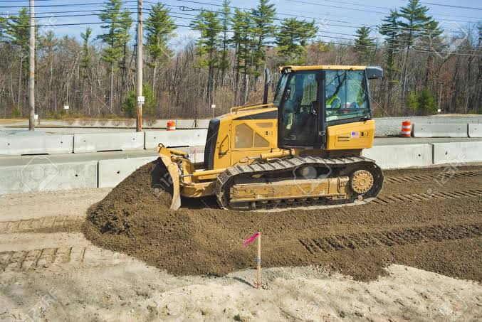
Bulldozer
Bulldozer is considered to be a versatile machine for construction projects as it may be used for clearing site, opening up roads, moving earth for short haul distance of about 100m and also in several other jobs.

Slide 3
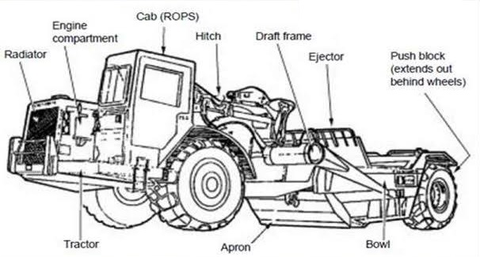
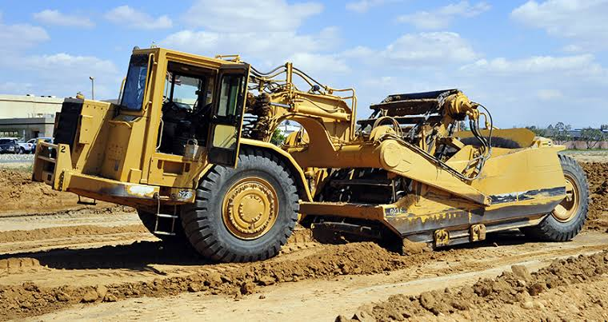
Scraper
It is useful earth-moving equipment over relatively smooth areas, as it is self operating – it can dig, haul and discharge the material in uniformly thick layers. It consists of wagon with a gate having a bladed bottom. The blade scrapes up earth as the wagon pushes forward and forces the excavated material into the wagon. When the wagon is filled, the gate is closed and material is carried to the place of disposal.

Slide 4
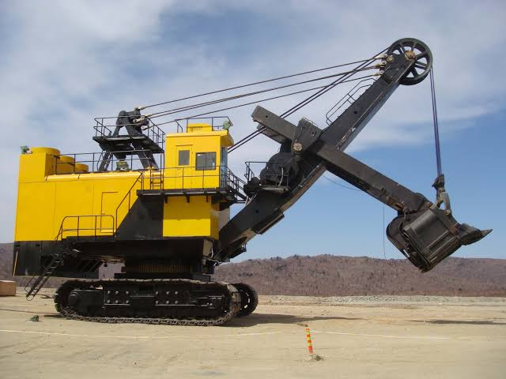
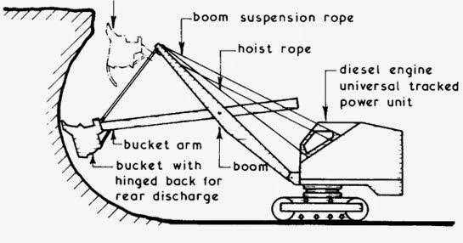
Power Shovel
It is primarily used to excavate earth of all classes except rock and to load it into wagons. Power shovels may be mounted on crawler tracks and so they can move at low speeds. The power shovel can effectively operate to excavate earth from a lower level where it stands and when the depth of the face to be excavated is not too shallow.

Slide 5
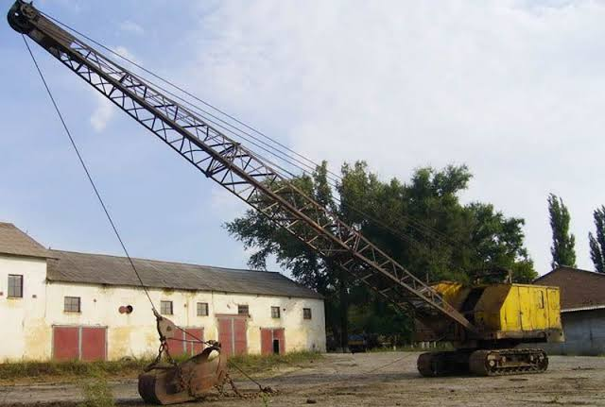
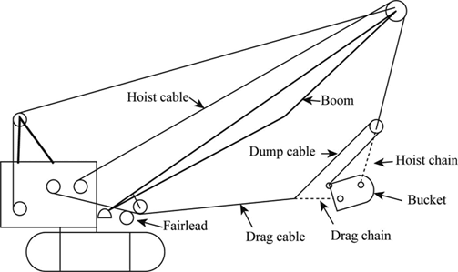
Dragline
It is used to excavated soft earth and to deposit in nearby banks or to load into wagons. Dragline may also be mounted on crawler. It can operate on natural ground while excavating from a pit with the bucket; thus it is not necessary for the dragline to go into the pit in order to excavate. The bucket is thrown out from the dragline on the top of the earth to be excavated and then pulled back towards the base of the machine.

Slide 6
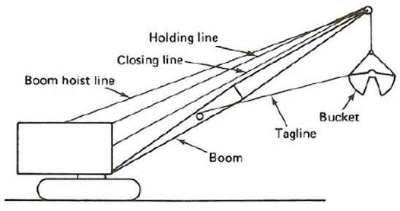
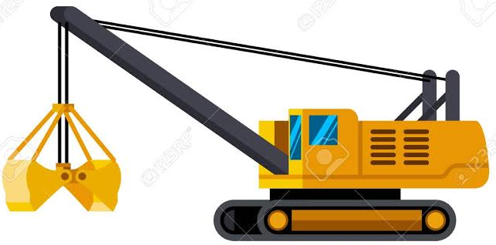
Clamshell
It consists of a bucket of two halves or shell which are hinged together at top. The shells may be attached to the shovel – crane units or at the boom of a dragline. The open clamshell bucket is thrown on the top of the loose material to be dug and as the bucket is lifted, two halves close entrapping the material into the bucket. This equipment is useful for excavation of soft to medium materials and loose material at or below existing ground surface.

Slide 7
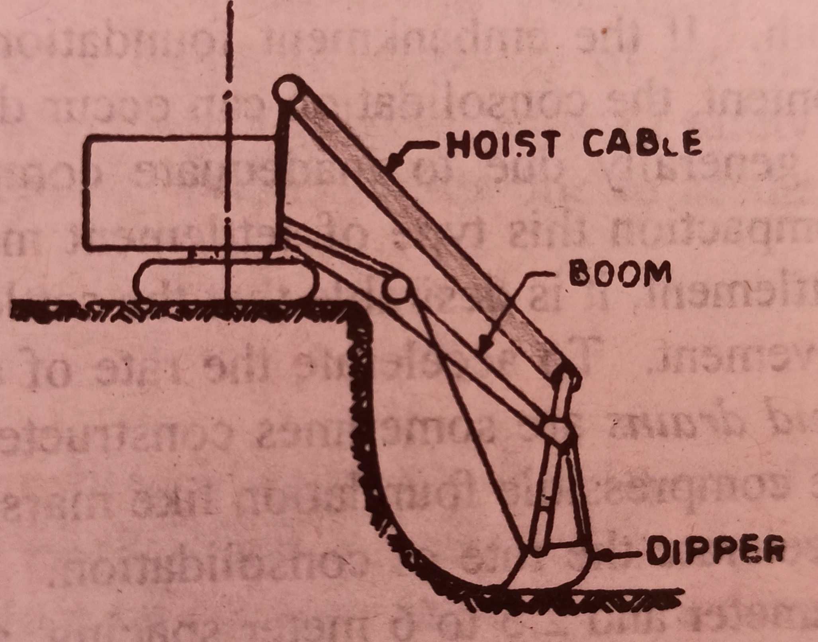
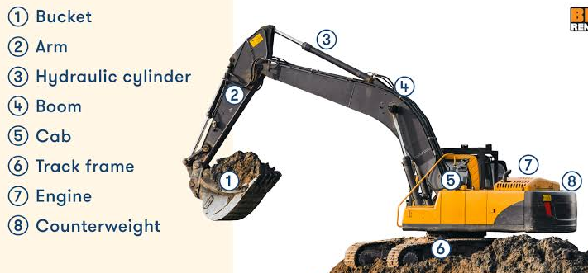
Hoe
Hoe is an excavating equipment of the power – shovel family. Hoe is meant to excavate below the natural surface where the machine is stationed and is capable of having precise control of depth of excavation at close range work. Hoe can exert high tooth pressure and hence can excavate stiff material which normally can not be excavated by dragline.

Slide 8
Principles of field compaction of subgrade
The preparation of subgrade includes all operations before the pavement structure could be laid over it and compacted. The various factors influencing soil compaction include the moisture content, amount and type of compaction, soil type and stone content. It is a well known fact that there is an optimum moisture content (OMC) for a soil which would give maximum dry density for a particular type and amount of compaction. Hence it is always desirable to compact the soil at the OMC after deciding the compacting equipment.
Compacting Equipment
Rollers: Smooth Wheeled Rollers, Pneumatic Tired Roller, Sheepsfoot Roller
Rammers
Vibrators
Water Jetting and Ponding

Slide 9
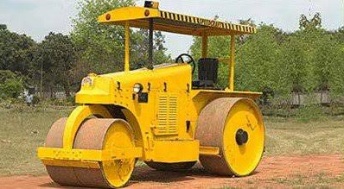
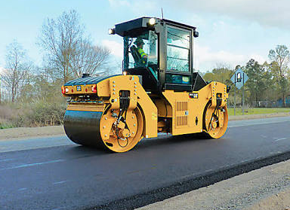
Rollers
1. Smooth Wheeled Rollers: Three – Wheeled or macadam rollers (having two wheel at rear and one in front) and tandem rollers (having one wheel at rear and one wheel in front).
Three-Wheeled Roller
The gross weight of the 3-wheeled type roller range b/w 4 to 18 tones whereas that of latter type with two axles varies between 1 to 14 tones. The compacting efficiency of the smooth wheeled roller depends on the weight, width and diameter of each roller. The smooth wheeled rollers are suitable to roll a wide range of soils, preferably granular soils and pavement materials for the various layers. These are particularly found to be used in compacting soils and other materials where a crushing action is advantageous.
Tandem-Wheeled Roller

Slide 10
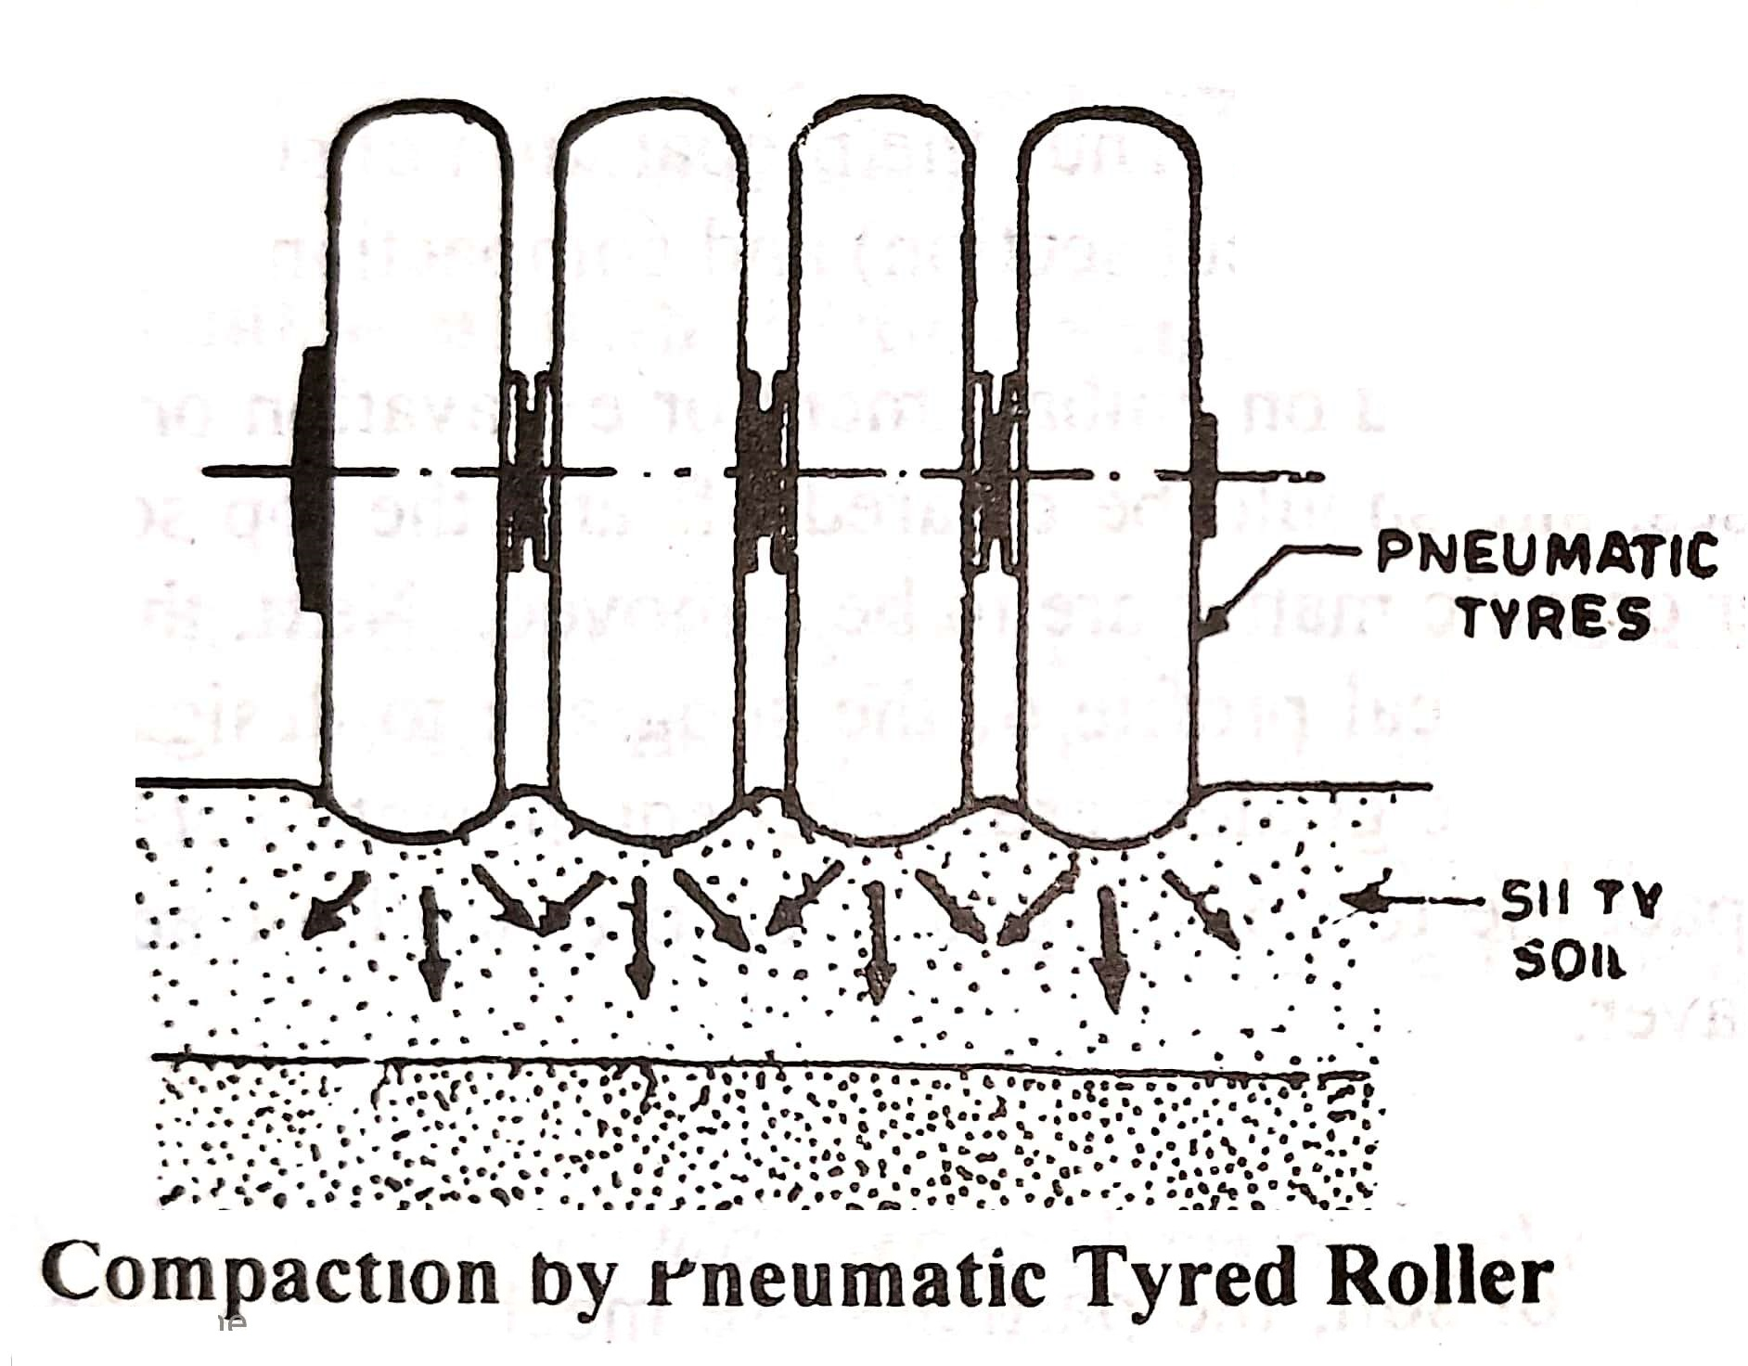
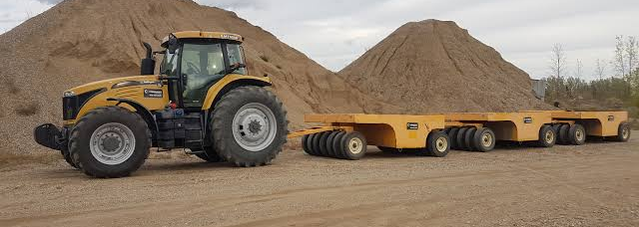
Rollers
2. Pneumatic Tired Rollers: In this type number of pneumatic wheels are mounted on two or more axles, under a loading platform. These rollers are pulled by tractors. The pneumatic tired rollers are considered to be most suitable to compact non-plastic silts and fine sands. In addition to the direct pressure due to rolling, there is also a slight kneading action.

Slide 11
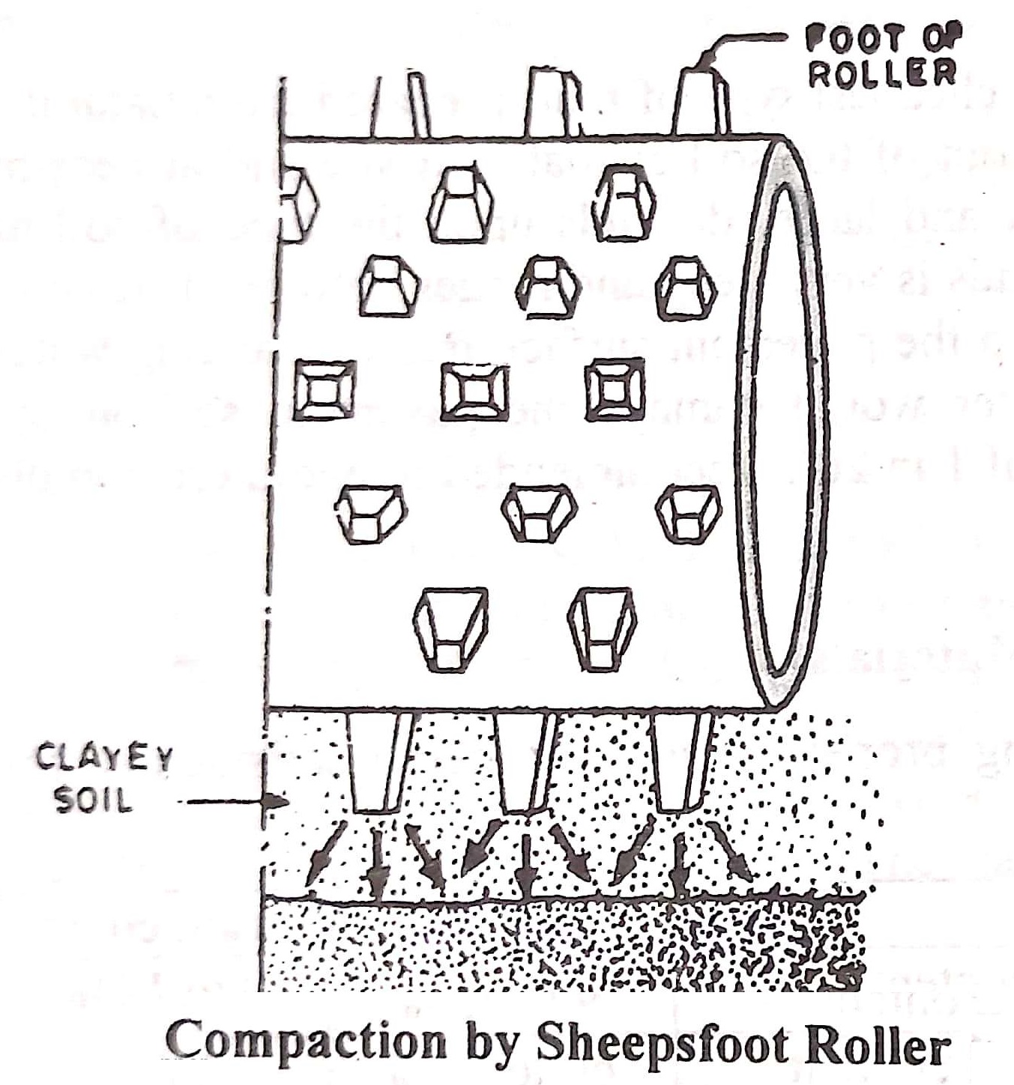
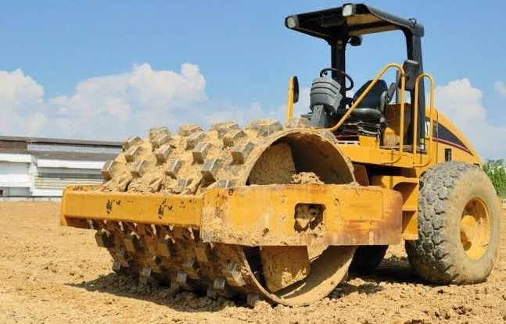
Rollers
3. Sheepsfoot Roller: This type of roller consists of hollow steel cylinder with projecting feet. The weight of the roller can be increased by filling the drum with wet soil. The weight, diameter and width of the roller may be varied and also the shape and size of the feet. Sheepsfoot rollers are considered more suited to compact clayey soils. About 24 or more number of passes of the roller may be necessary to obtain adequate compaction.

Slide 12
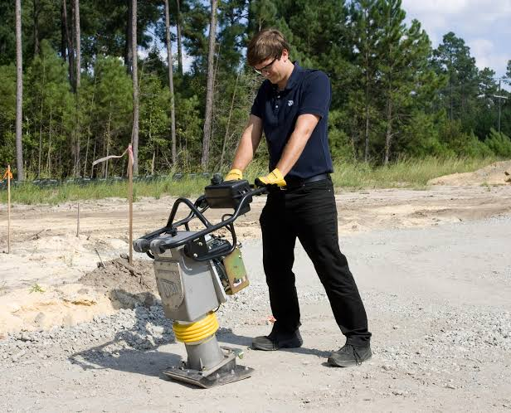
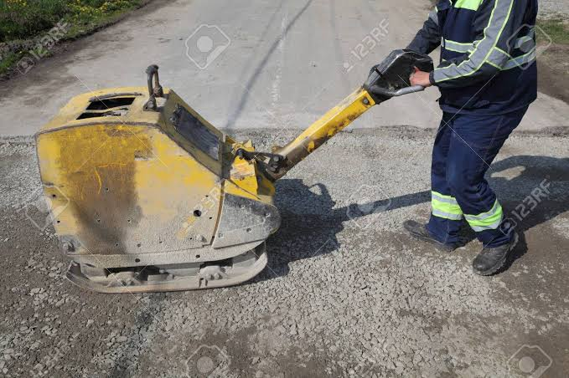
Rollers
4. Rammers: Rammers are useful to compact relatively small areas and where the rollers cannot operate such as compaction of trenches, foundation and slopes. The output rammer is much lower than that of roller.
5. Vibrators: Vibrators are most suited for compacting dry cohesionless granular material. There are also vibrator mounted roller to give the combined effects of rolling and vibration. Vibratory rollers are advantageously used in compacting a wide range of materials.
6. Watering (Jetting and Ponding): is considered to be efficient method of compacting cohesionless sands. Watering heavily and rolling by smooth wheel of pneumatic tired roller may also give adequate compaction of cohesionless sands.

